Slide 1
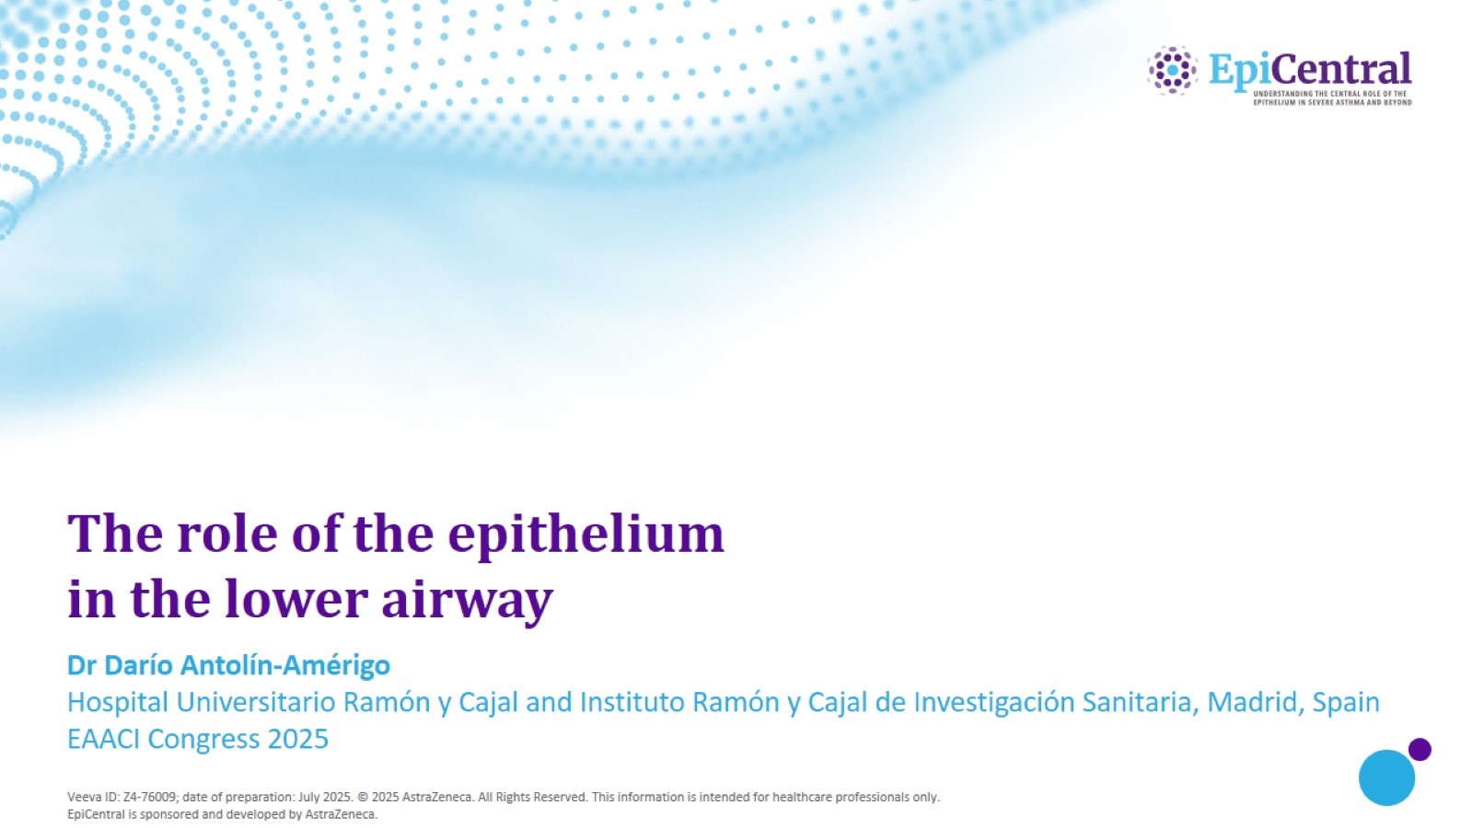
The role of the epithelium in the lower airway

Slide 2
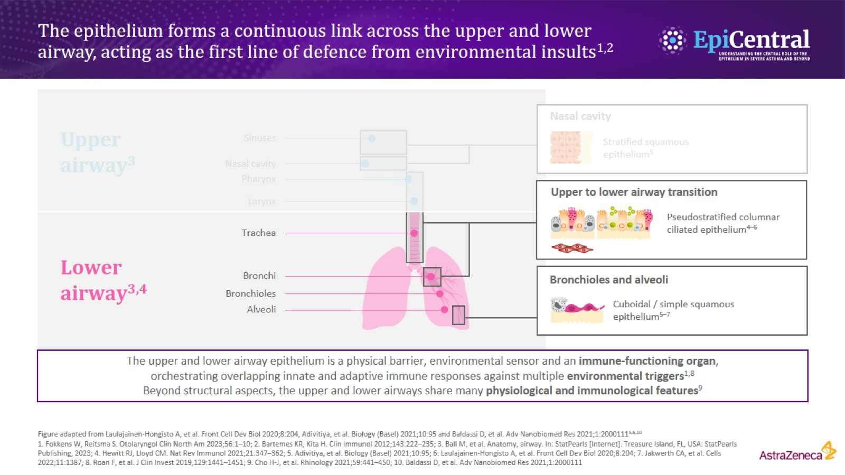
The epithelium forms a continuous link across the upper and lower airway, acting as the first line of defence from environmental insults^{1,2}

Slide 3
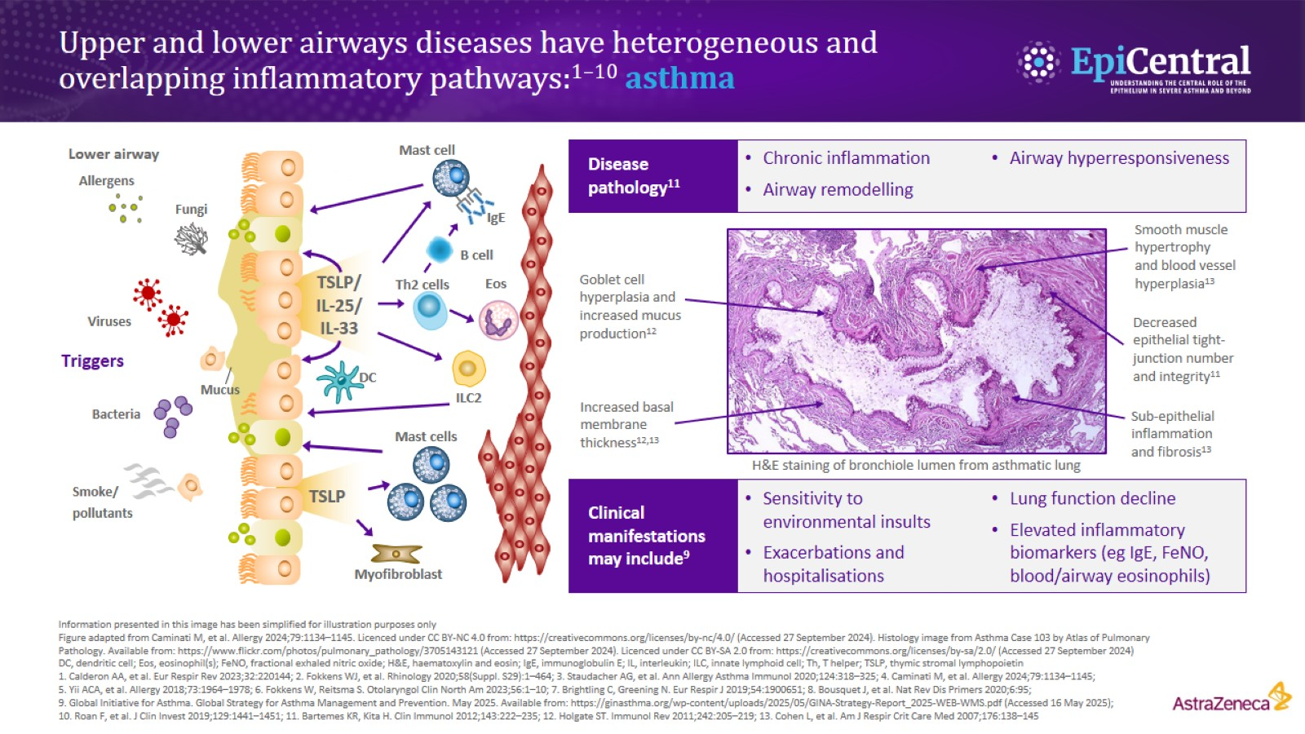
Upper and lower airways diseases have heterogeneous and overlapping inflammatory pathways:^{1–10} asthma

Slide 4
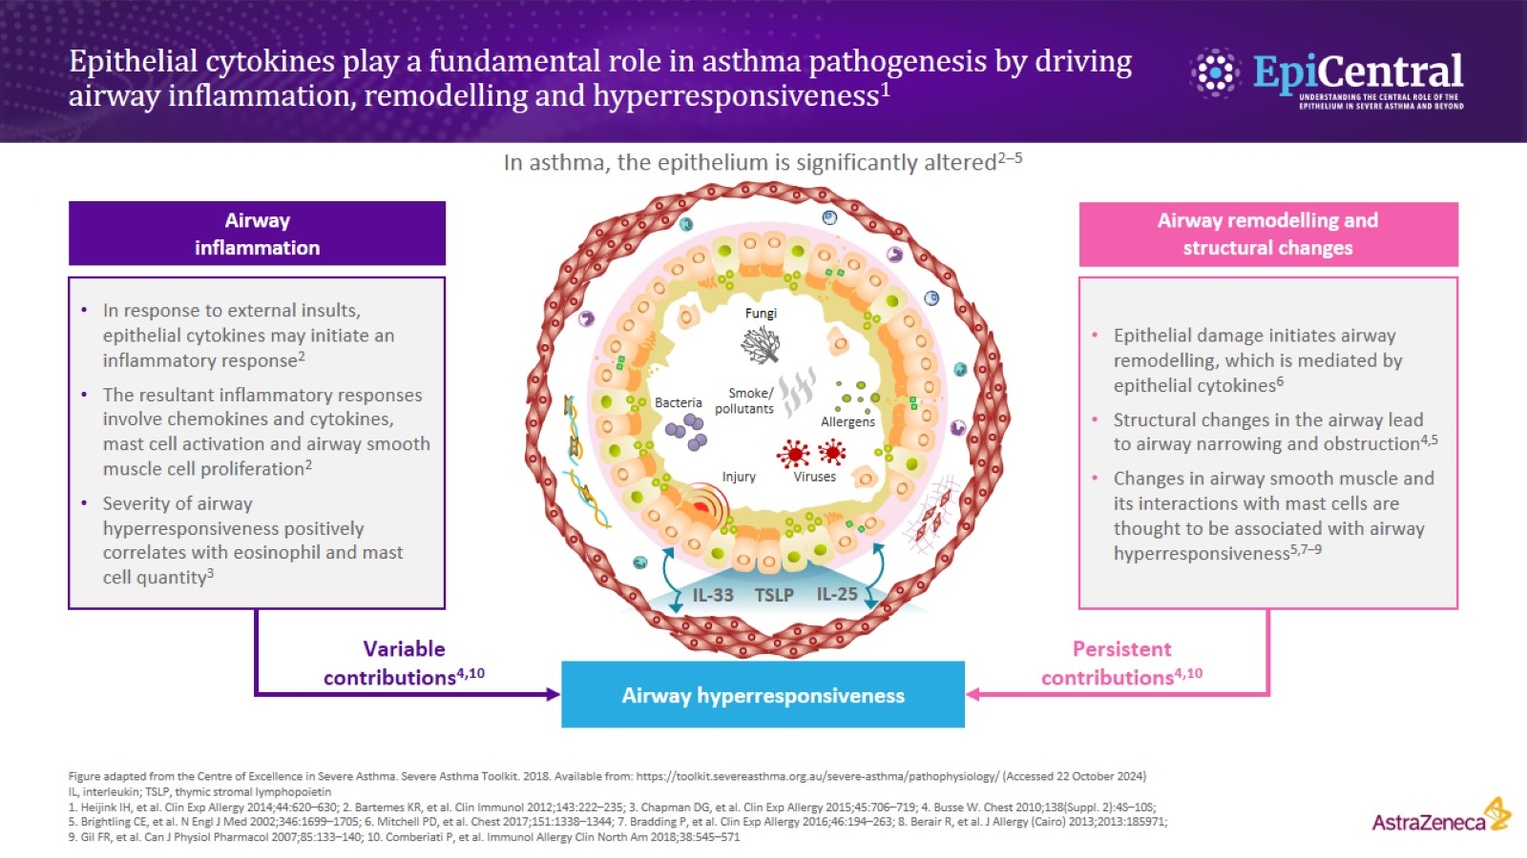
Epithelial cytokines play a fundamental role in asthma pathogenesis by driving airway inflammation, remodelling and hyperresponsiveness¹

Slide 5
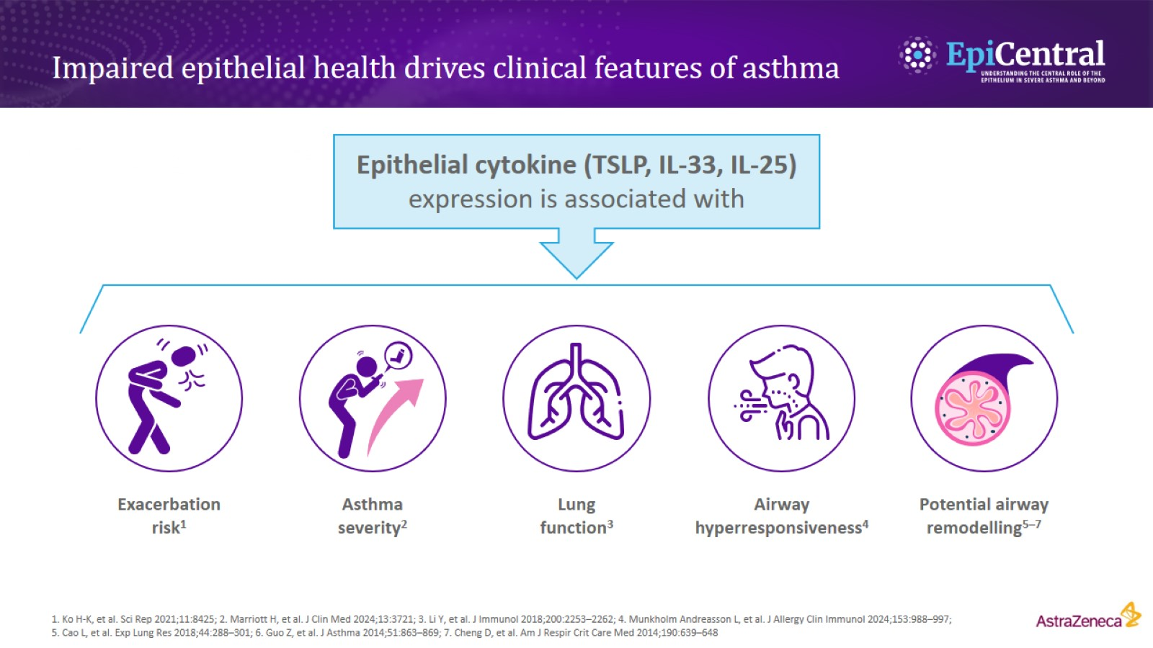
Impaired epithelial health drives clinical features of asthma

Slide 6
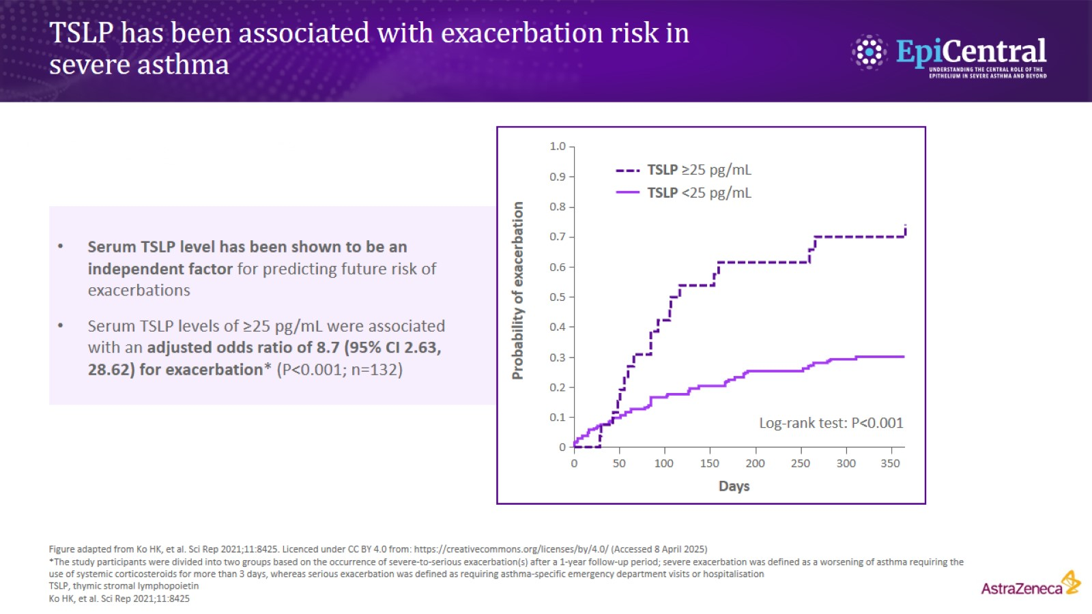
TSLP has been associated with exacerbation risk in severe asthma

Slide 7
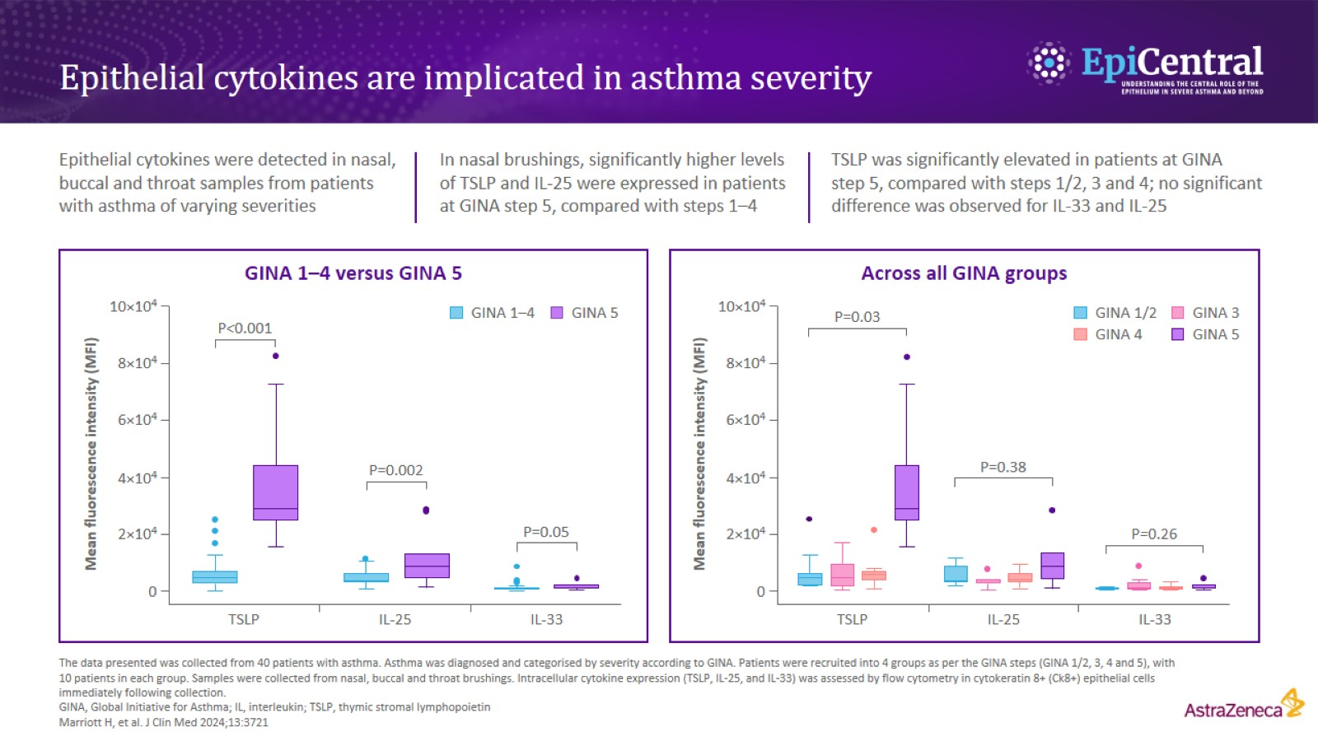
Epithelial cytokines are implicated in asthma severity

Slide 8
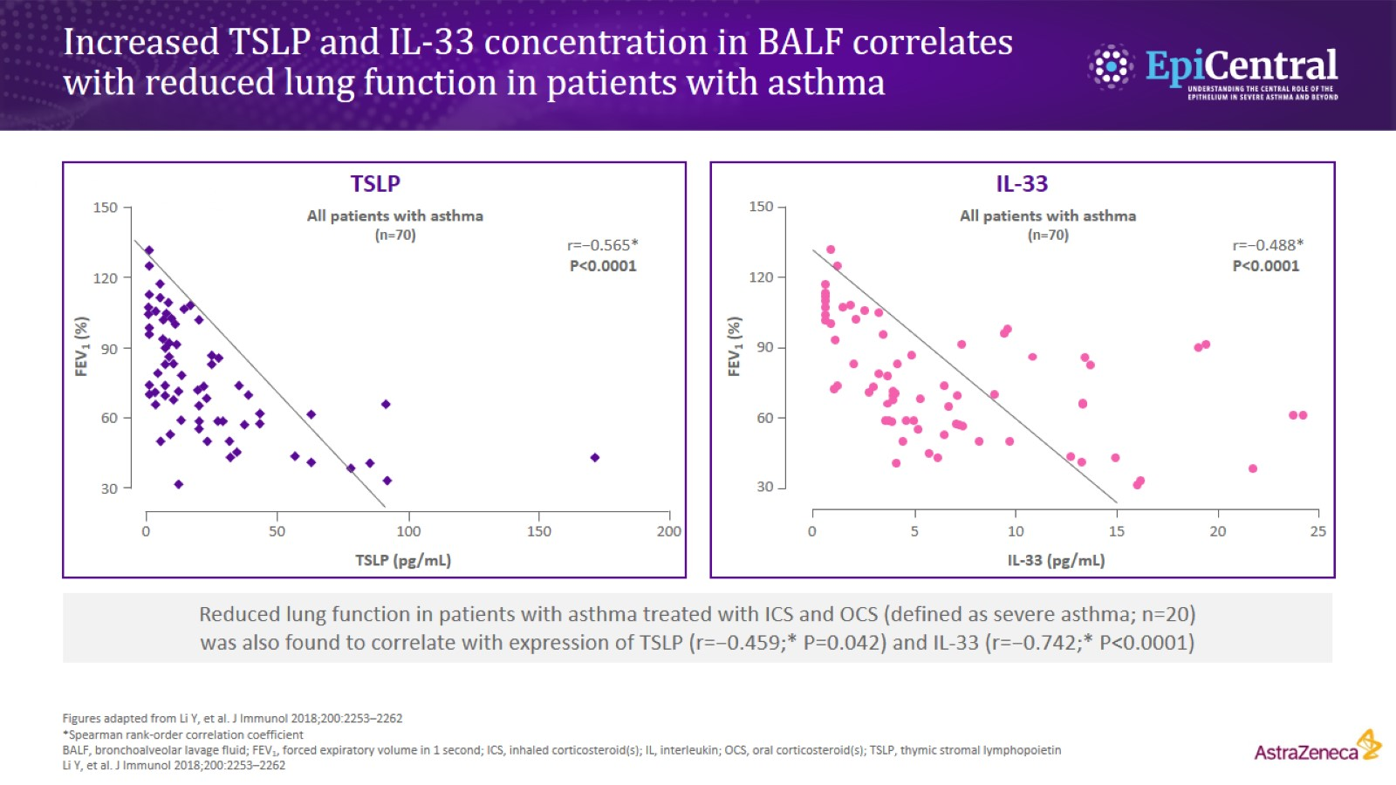
Increased TSLP and IL-33 concentration in BALF correlates with reduced lung function in patients with asthma

Slide 9
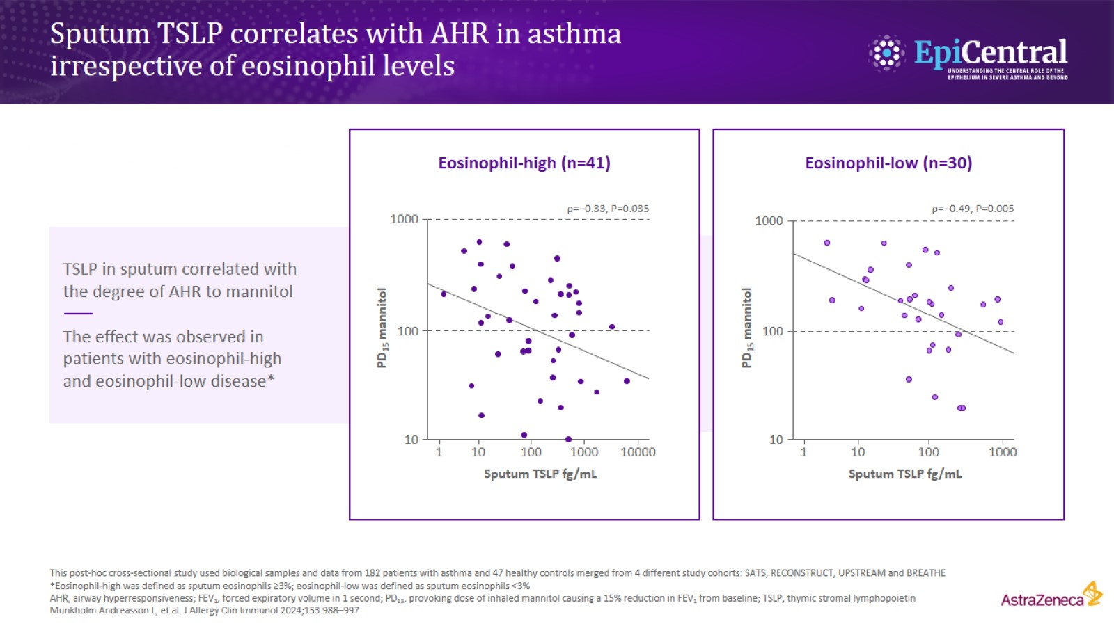
Sputum TSLP correlates with AHR in asthma irrespective of eosinophil levels

Slide 10
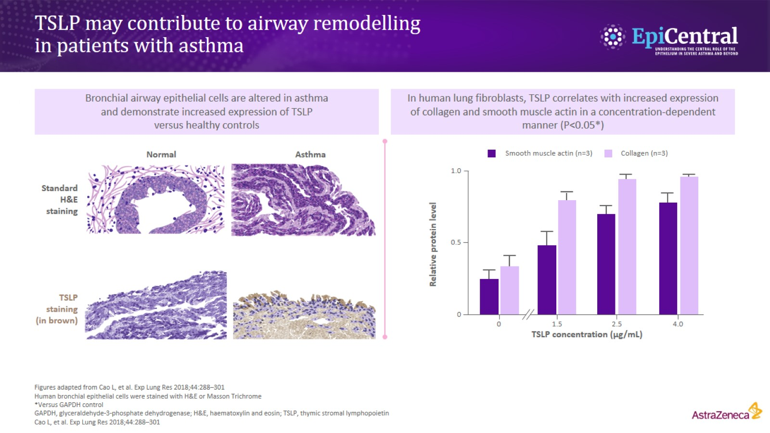
TSLP may contribute to airway remodelling in patients with asthma

Slide 11
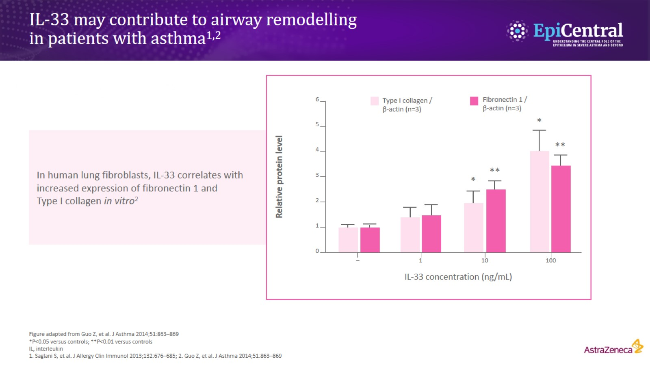
IL-33 may contribute to airway remodelling in patients with asthma^{1,2}

Slide 12
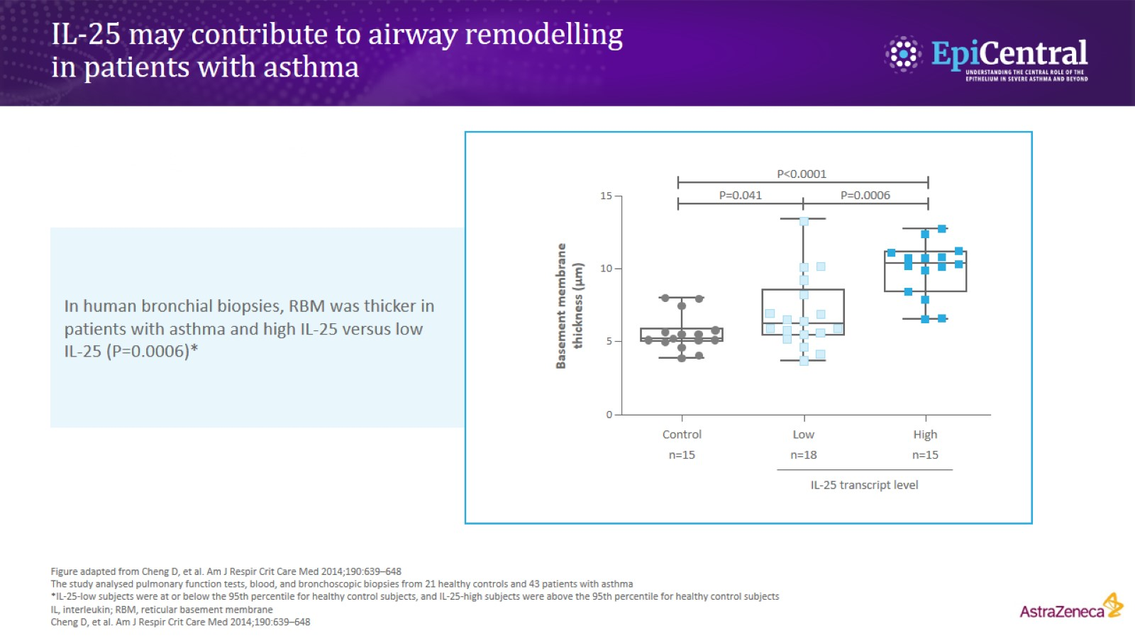
IL-25 may contribute to airway remodelling in patients with asthma

Slide 13
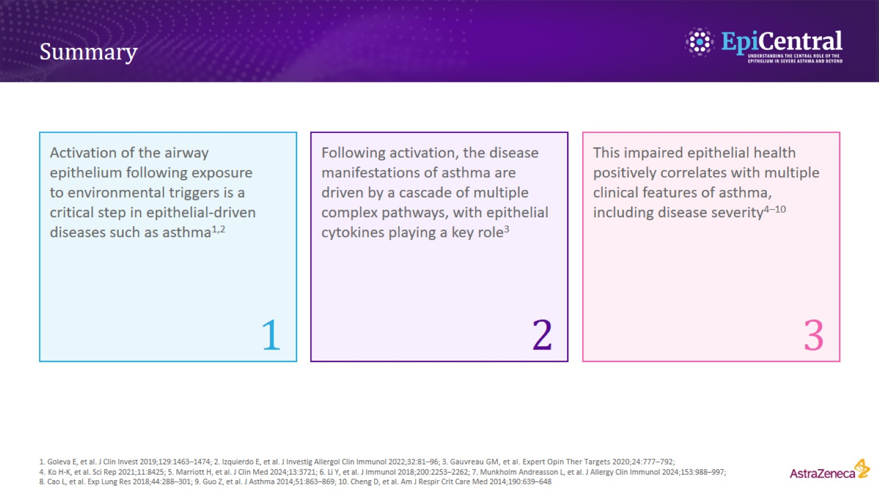
Summary

